Slide 1
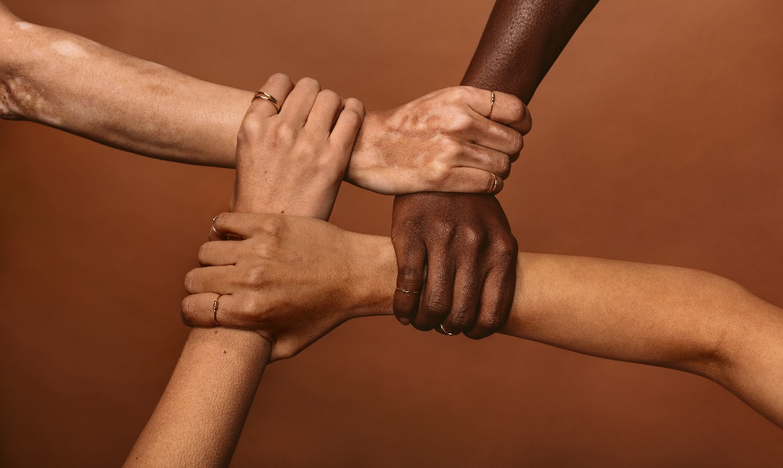
Appreciate Diversity and Inclusiveness, and Their Benefits
CHCDIV001 - Work with diverse people (Release 1)

Slide 2




How you communicate and interact with others is a good measure of your cultural awareness.
Taking cultural diversity into consideration in your interactions can help prevent misunderstandings and build positive relationships.
Appreciate Diversity and Inclusiveness, and Their Benefits

Slide 3
A conscientious worker:
Respects and recognises diversity
Understands that all persons, regardless of their religion, race, gender, beliefs, or culture, deserve to be treated with courtesy
Understands that people have a right to be different yet treated equally
Supports the needs of people and prevents their prejudices from affecting the service they provide
Appreciate Diversity and Inclusiveness, and Their Benefits

Slide 4

2.1 Respect and Value Inclusiveness and Diversity Across All Areas of Work

Slide 5
2.1 Respect and Value Inclusiveness and Diversity Across All Areas of Work
Cultural diversity refers to differences between aspects or characteristics of cultures. In a workplace, having cultural diversity is unavoidable.
Employees from diverse cultures bring their unique experiences, perspectives, and skills as contributions to the organisation’s work practices.
Inclusiveness is allowing equal opportunities and participation to people despite differences in culture.
Clients from diverse cultures also bring unique expectations, ideas and beliefs to make every interaction interesting and challenging.
Appreciate Diversity and Inclusiveness, and Their Benefits

Slide 6
There are levels to respecting diversity in the workplace, which can involve:
Accepting and respecting differences between ideas
Treating co-workers, clients, and other members of the community equally regardless of their race, ethnicity, gender, sexual orientation or economic status
Allowing people to practice their cultural beliefs and customs without prejudice, spite, or hindrance from co-workers, clients, or other members of the community
Making resources, promotional materials, and spaces available, accessible and inclusive for all
Appreciate Diversity and Inclusiveness, and Their Benefits

Slide 7
Respecting diversity means that within the workplace, all organisation members must value and protect each individual's practices, values and beliefs.
Respecting diversity across all areas of work can be done by:
Honouring the histories, cultures, languages, traditions, child-rearing practices and lifestyle choices of families
Valuing workers’ different capacities and abilities
Free your workplace with culturally insensitive materials
Respecting differences in opinions
Appreciate Diversity and Inclusiveness, and Their Benefits

Slide 8

Value diversity across all areas of work means considering the importance of the differences in the workplace. This can be done by:
Appreciating people’s values
Not imposing personal values
Taking time to understand other people’s cultures
Following diversity policies and procedures.
Appreciate Diversity and Inclusiveness, and Their Benefits

Slide 9
Respecting inclusiveness across all areas of work means recognising and protecting equal opportunities and participation in the workplace. This can be done by:
Being open to all
Helping your organisation implement equal access to benefits and working conditions
Participating in surveys or consultations on workplace inclusiveness
Appreciate Diversity and Inclusiveness, and Their Benefits

Slide 10

Valuing inclusiveness across all areas of work means considering the importance of equal opportunities and participation in the workplace. This can be done by:
Avoid stereotyping
Never discriminating
Never excluding people because of cultural differences
Recognising equal human dignity despite differences
Appreciate Diversity and Inclusiveness, and Their Benefits

Slide 11
2.1.1 Diversity in Australia
Australia is home to many different people.
You are bound to already have some experiences regarding the diverse groups of people that call this country their home.
Diversity, however, can differ across different areas of life for Australians.
Cultural Diversity
Culture, as previously discussed, is the collection of a group of people's values, behaviour and knowledge.
Cultures can constantly develop and change over time.
Appreciate Diversity and Inclusiveness, and Their Benefits

Slide 12

These are strongly influenced by:
Environment locally
Local politics and history
Major events, made by humans or natural
Interactions with other cultures
Appreciate Diversity and Inclusiveness, and Their Benefits

Slide 13
According to the Australian Bureau of Statistics, in 2021:
27.6 per cent of the population were born overseas.
61,860 international visitors were in Australia during the Census collection period.
The top 5 languages used at home, other than English, were Mandarin (2.7%), Arabic (1.4%), Vietnamese (1.3%), Cantonese (1.2%) and Punjabi (0.9%).
Appreciate Diversity and Inclusiveness, and Their Benefits

Slide 14
According to the Australian Bureau of Statistics, in 2021:
The top 5 ancestries were English (33.0%), Australian (29.9 %), Irish (9.5%), Scottish (8.6%) and Chinese (5.5%).
The top 5 religious affiliations were No religion (38.9%), Catholic (20%), Anglican (9.8%), Islam (3.2%) and Hinduism (2.7%).
Appreciate Diversity and Inclusiveness, and Their Benefits

Slide 15

Cultural diversity affects people in various ways:
People can find it challenging to interact with persons from other cultures.
People from diverse backgrounds can find comfort in knowing that other groups like them have beliefs, practices and customs that are different from the majority group.
Appreciate Diversity and Inclusiveness, and Their Benefits

Slide 16
Social Diversity
Social diversity has produced the following effects in different social contexts:
Many Australians experience ‘diversity within diversity.’ It is where their lives are influenced by their cultural background and the culture of the people they interact with.
Aboriginal and Torres Strait Islanders see the presence of diverse groups as a reason to be more proud of their culture.
People of diverse backgrounds are generally satisfied with their lives.
Appreciate Diversity and Inclusiveness, and Their Benefits

Slide 17
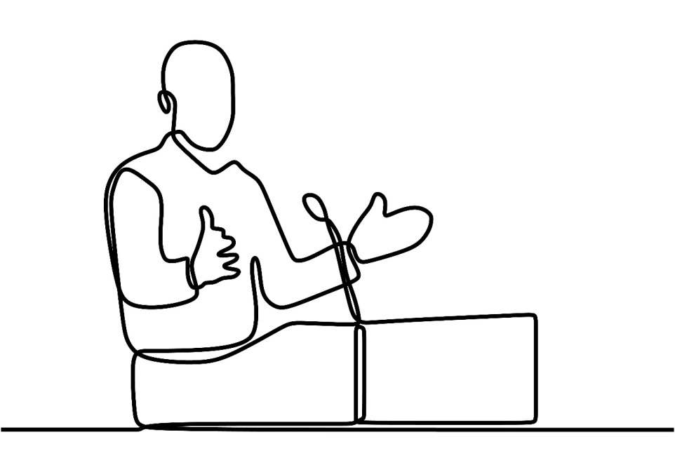
Political Diversity
Australian politics is severely lacking in diversity.
In 2018, only 4% of federal members of parliament had non-European ancestry to represent the diverse people, which makes up 19% of the total Australian population.
This underrepresentation is apparent across different local communities as well.
Appreciate Diversity and Inclusiveness, and Their Benefits

Slide 18
This underrepresentation of diverse cultures in Australian Politics affects groups of people in extremely negative ways:
Many groups regard their government as ‘out of touch’ with current realities and the plights of the common man.
Diverse people develop a sense of inferiority and low self-confidence due to not having a role model to look up to.
Diverse people are less enthusiastic about supporting government-led initiatives and programs.
Appreciate Diversity and Inclusiveness, and Their Benefits

Slide 19
Economic Diversity
Australia is severely lacking in economic diversity and is known for exporting materials and products from mining and agricultural activities.
Most people are expected to work in these industries or related fields, but due to technologies involving renewable energy sources advancing, the global demand for coal and gas continuously decreases.
Additionally, the demand for steel ores and other mining products is heavily dependent on the demands of a limited group of countries.
Appreciate Diversity and Inclusiveness, and Their Benefits

Slide 20
Education is also one of Australia's major international products and services.
An increase in competitors providing education services can cause sudden problems for Australia’s economy. These factors affect diverse people in various ways:
Diverse people are counted on to contribute to Australia’s workforce.
People from diverse backgrounds may also see some restrictions on their employment opportunities.
In the mining industry, there are people from cultures that highly value protecting nature and preserving natural resources.
Appreciate Diversity and Inclusiveness, and Their Benefits

Slide 21
Effects of Various Influences on Diverse Groups in Australia
The following are some of the more common factors that have affected the lives of people from diverse backgrounds:
Factor | Influence
Multiculturalism | Australians now have a wider array of services, product options, food choices and possible designs to choose from because of its embrace of multiculturalism.
Access to alcoholic beverages | People from diverse backgrounds who take to alcohol through Australian services can suffer from many negative effects, such as addiction and the development of health problems.
Appreciate Diversity and Inclusiveness, and Their Benefits

Slide 22
The following are some of the more common factors that have affected the lives of people from diverse backgrounds:
Factor | Influence
Sports | Australia’s love of sport directly impacts the number of opportunities available for people to play sports, attend sporting events, and watch televised shows.
The pearling industry | Australia’s history is replete with indigenous exploitation that treated diverse people as cheap labours and forced them into dangerous practices.
Appreciate Diversity and Inclusiveness, and Their Benefits

Slide 23
The following are some of the more common factors that have affected the lives of people from diverse backgrounds:
Factor | Influence
The farming industry | The farming industry has provided employment opportunities for many diverse people.
Religion | Australia is among the most diverse country in terms of religion. This significantly affects the challenge of promoting harmonious and respectful relations among people of different religions.
Appreciate Diversity and Inclusiveness, and Their Benefits

Slide 24
2.1.2 The Western Culture
Western culture is a broad term referring to cultures patterned after or directly inherited from European culture.
Australia is largely Western in terms of its culture.
The following are the defining characteristics of Western Culture:
Democracy and liberty
Individualism and Human rights
A scientific or rational approach to problem-solving
Christianity
Capitalism
Technologically-aided way of living
Appreciate Diversity and Inclusiveness, and Their Benefits

Slide 25
Western Systems
Western systems refer to the west’s set of principles and procedures for performing actions and carrying about daily life.
Western countries such as Australia believe in using a rational approach to thinking and philosophy which involves requiring proof as a basis of belief.
The west makes use of large-scale authority systems.
You can find an organised authority system in religion, government or other social groups.
Appreciate Diversity and Inclusiveness, and Their Benefits

Slide 26

Western Structures
Western structures refer to the west’s set of social institutions and patterns of relationships, such as in communities, families and governments.
The structure of western society can be described as compartmentalised.
Divisions exist between social institutions and groups, with each unit of society having a defined role to perform.
Appreciate Diversity and Inclusiveness, and Their Benefits

Slide 27
Western society features a chiefly capitalist market and follows a legalistic approach to regulating and policing its citizen’s actions.
Western society also features a small power distance culture where social or class inequalities do not prevent one person from questioning or challenging authority figures.
People from diverse backgrounds may act and behave in a way that is more consistent with the systems and structures of their cultural group.
Appreciate Diversity and Inclusiveness, and Their Benefits

Slide 28
2.1.3 Points of Diversity
When working with diverse people, you must consider the many different traits and attributes of people you will encounter in your workplace.
Ethnicity
It is not culture, but is linked with cultural expression and identification.
It is reflected in the food, art, styles, music, material culture and other preferences of people in the group.
An ethnic group is a socially defined category of people that identify based on ancestry or shared social experiences.
Appreciate Diversity and Inclusiveness, and Their Benefits

Slide 29

Race
It refers to people of a common language and national affiliations.
It is associated with biology and comprises physical characteristics such as skin colour or hair texture.
It is often assumed to be the essential biological difference between different peoples.
Appreciate Diversity and Inclusiveness, and Their Benefits

Slide 30
Language
It is one of the more prominent and defining aspects of one’s culture.
It is seen as a human capacity for using complex systems to communicate, and humans have many language systems to do this.
It is not just vocal.
Both spoken and non-verbal language can be miscommunicated between cultures, creating conflicts.
Appreciate Diversity and Inclusiveness, and Their Benefits

Slide 31
Sports Preferences
Sports are recreational activities involving skills.
They are venues where an individual or group competes against another for entertainment.
Influences are from British and American to the increasing presence of a distinct Australian culture.
While this can bring people together, sports can also be a divisive tool depending on a group or individual's mentality.
Appreciate Diversity and Inclusiveness, and Their Benefits

Slide 32

Disability
It is a condition that limits a person’s capabilities.
It comes in many forms and can encompass various aspects of a person’s life.
It is defined differently by various groups.
A person with disability can experience difficulties related to their health condition, body functions, and participation in communal activities.
Appreciate Diversity and Inclusiveness, and Their Benefits

Slide 33
Cultural Norms
Cultural norms are typically seen as behaviour patterns that a cultural group demonstrates.
A person growing up will typically accept the behaviours of people around them as ‘normal’.
By putting someone in the ‘normal’ category, they are using it as an excluding concept that often prevents acknowledgement of the diversity of people, their life experiences and situations.
Appreciate Diversity and Inclusiveness, and Their Benefits

Slide 34
Cultural Values
Values are the principles, beliefs, and practices considered intrinsically desirable by a cultural group.
Cultural groups install values during early childhood training, and children grow up to accept these as the way things should be.
In Western societies, professional notions of healthy behaviour and appropriate interaction reflect many of the values of the dominant, mainstream Australian culture inherited from Northern European ancestors.
Appreciate Diversity and Inclusiveness, and Their Benefits

Slide 35
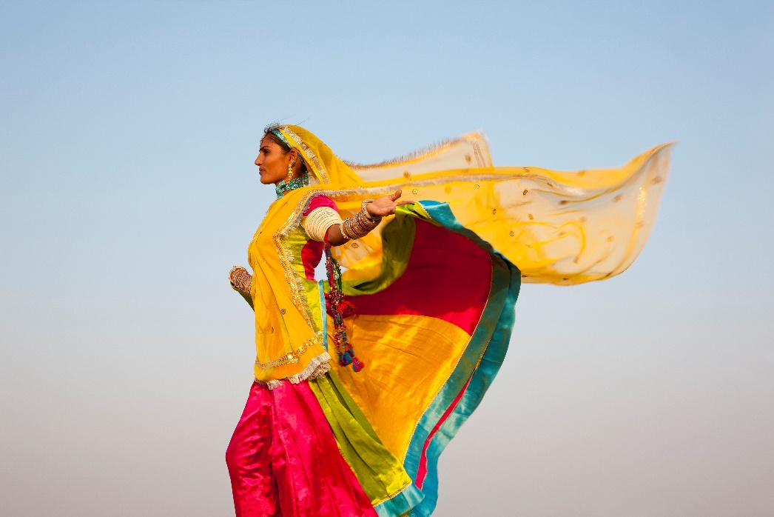
People who want to work with diversity must examine how these deeply ingrained values influence their actions and behaviours before they can handle working with diverse people.
Appreciate Diversity and Inclusiveness, and Their Benefits

Slide 36
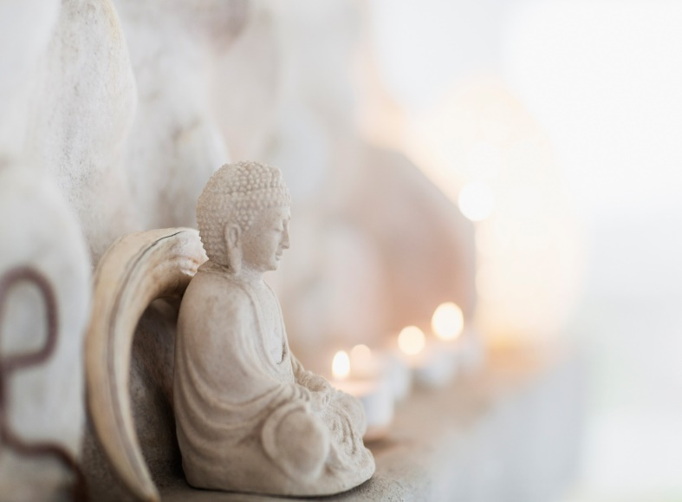
Religions and Beliefs
Religions and belief systems contain behaviours, customs, rituals, practices, symbols and values acquired through practising the ‘belief’ as a group.
Religious beliefs comprise a specific set of organised beliefs and practices shared by a community or group.
They usually include a belief in some reality beyond, yet connected, to human experience and existence.
Appreciate Diversity and Inclusiveness, and Their Benefits

Slide 37
Meanwhile, spiritual beliefs have to do with having a sense of peace and purpose, are characterised by individual practice and includes developing beliefs around the meaning of life and connection with others.
Each cultural group subscribes to a specific set of religious or spiritual beliefs.
One group’s beliefs may be different to another’s even though they subscribe to the same philosophy or system.
Appreciate Diversity and Inclusiveness, and Their Benefits

Slide 38
Customs and Traditions
Customs are a set of agreed or accepted rules, norms, standards or criteria that a group of people follows.
On the other hand, traditions are long-established customs or beliefs passed through generations.
In a safe work environment, everyone must be sensitive to the cultural beliefs and traditions of others.
Appreciate Diversity and Inclusiveness, and Their Benefits

Slide 39
Gender Relationships
A gender role is a set of social norms comprised of masculine or feminine behaviours appropriate for a man or a woman in a social or interpersonal relationship.
Gender includes the norms, roles, and relationships of and between women and men and how men and women should interact with others of the same or opposite sex within households, communities, and workplaces.
Appreciate Diversity and Inclusiveness, and Their Benefits

Slide 40

Culture determines and teaches attitudes about gender, femininity, sexuality and the acceptable practices surrounding them.
This training starts in early childhood, and many children have learnt this by about three years old.
Appreciate Diversity and Inclusiveness, and Their Benefits

Slide 41

Sexuality
Different cultures have different attitudes and beliefs about what constitutes sexual morality.
For many cultures, these beliefs are upheld in their religion.
A person’s acceptance of the teachings of a particular religion is more important as a factor in sexual behaviour than a specific religion.
Appreciate Diversity and Inclusiveness, and Their Benefits

Slide 42
Sexual identity is how one thinks of oneself regarding whom one is romantically or sexually attracted.
Sexual orientation involves a person’s emotional, romantic, and sexual feelings or fantasies.
Among these are:
Gays and lesbians
Bisexuals
Heterosexuals
Intersexes
Transgender
Appreciate Diversity and Inclusiveness, and Their Benefits

Slide 43
Age
Every culture typically demonstrates unique attitudes to behaviours of age groups and what they see as socially acceptable behaviours.
Generational diversity includes people of various ages expressing generational differences, attitudes, and values.
Whether a person of a certain age is seen as a baby, a child, an adolescent, or an adult can be greatly influenced by the culture in which they live.
Appreciate Diversity and Inclusiveness, and Their Benefits

Slide 44

Kinship, Family Structure, and Relationships
Different societies classify relations differently.
An example of relations is kinship, and there are different systems of terminology for kinship.
Kinship generally refers to the social relationships about human mating, gestation, parenthood, socialisation and siblingship.
Appreciate Diversity and Inclusiveness, and Their Benefits

Slide 45
2.1.4 Aboriginal and Torres Strait Islander Culture
Aboriginal and Torres Strait Islander and Indigenous are labels of colonials on a range of people with extremely diverse cultures and languages.
Indigenous is often used by the government when providing programs and services to Aboriginal and Torres Strait Islanders at a national level.
Aboriginal is a term that specifically refers to Aboriginals of the Australian mainland and does not necessarily include other indigenous populations of Australia and Torres Strait Islanders.
Appreciate Diversity and Inclusiveness, and Their Benefits

Slide 46
When writing or discussing Aboriginal and Torres Strait Islanders, it is disrespectful to use acronyms such as A’s, TSIs or ATSIs.
Aboriginal and Torres Strait Islander culture has been a protective influence over the last two centuries, where a colonising culture has tried to impose itself on all aspects of Aboriginal and Torres Strait Islanders’ life.
Aboriginal and Torres Strait Islander people experience a lack of appropriate representation, exclusion, and hostility when accessing basic services such as education and healthcare.
Appreciate Diversity and Inclusiveness, and Their Benefits

Slide 47
This section will explore different topics involving the Aboriginal and Torres Strait Islander peoples. These topics can include:
Legislation
Stolen generations
Deaths in custody
Health
Education
Land Rights
Maralinga
Mabo
Religion
Appreciate Diversity and Inclusiveness, and Their Benefits

Slide 48
Health Issues
Aboriginal and Torres Strait Islander people suffer greater health burden.
Aboriginal and Torres Strait Islanders also suffer from discrimination based on race or culture, which can increase the risk of depression, substance misuse, and even suicide.
The racism and discrimination experienced by Aboriginal and Torres Strait Islanders may lead to poorer physical and mental health, including reduced access to education, employment, housing, medical care, and even injury from racially motivated assault and bullying.
Appreciate Diversity and Inclusiveness, and Their Benefits

Slide 49
Education Issues
There is still a negative relationship between poverty, health, housing, access to government services, socioeconomic status, and infrastructure to the educational achievement of Aboriginal and Torres Strait Islanders’ children.
Many Aboriginal children in Australia’s remote north still receive the most basic education services due to their far location, infrastructure shortfalls, and underfunding.
Western education can cause disengagement from what the children learn at school to the lives of the community, leading to intergenerational divisions and conflicts.
Appreciate Diversity and Inclusiveness, and Their Benefits

Slide 50
Economic Issues
Aboriginal unemployment rates are three times the non-Aboriginal rates.
This is coupled with other factors, including lack of access to education, poor training and skill levels, poorer health, and limited market opportunities.
Income and education impact an individual’s ability to ‘engage’ and ‘influence’ society.
Aboriginal and Torres Strait Islanders are known to have the lowest economic status of all Australians.
Appreciate Diversity and Inclusiveness, and Their Benefits

Slide 51
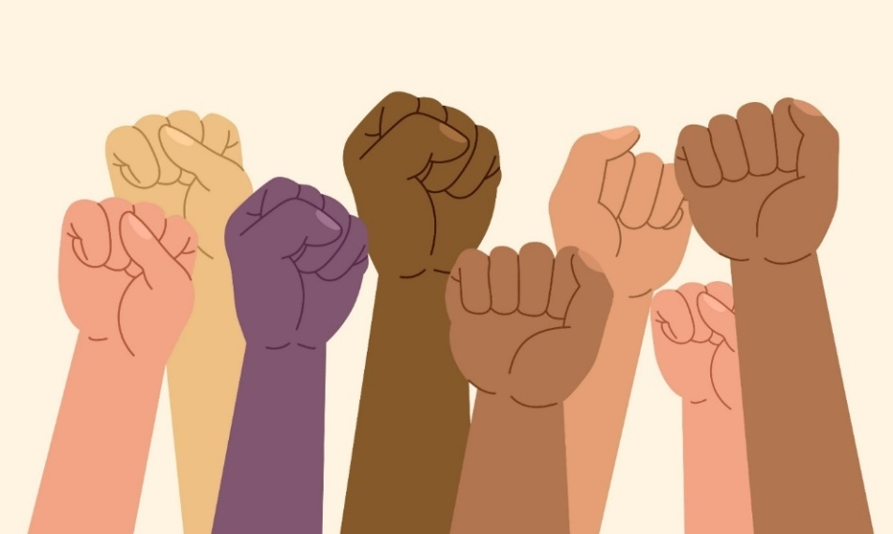
Poor socio-economic, education and employment levels have links to financial hardship, poverty, debt, homelessness, family breakdown, social isolation and crime.
Socio-political factors
Aboriginal and Torres Strait Islander people experience extreme levels of racism in Australia.
Appreciate Diversity and Inclusiveness, and Their Benefits

Slide 52
This is typified historically by their exclusion from elite and mainstream power structures.
Aboriginal and Torres Strait Islanders grow up learning two kinds of histories: memories preserved by their family and history provided in humiliating textbooks that do not recognise the depth of their culture.
Note that reconciliation can only occur when sovereignty is acknowledged through recognising past injustices, property rights and cultural practices.
Appreciate Diversity and Inclusiveness, and Their Benefits

Slide 53

Land Ownership
The land is fundamental to Aboriginal and Torres Strait Islanders, both individually and collectively.
To be dispossessed of their land means:
To move away from their traditional customs and practices
Appreciate Diversity and Inclusiveness, and Their Benefits

Slide 54
To be dispossessed of their land means:
They are compelled to assimilate into the culture brought upon by Western civilisation
An increased risk of homelessness and a lack of basic services (e.g. food)
The demand for civil and land rights has greatly impacted their struggle for a voice against the long-held intolerance and colonial invasion.
Appreciate Diversity and Inclusiveness, and Their Benefits

Slide 55
Religion
The perpetuation of Aboriginal and Torres Strait Islanders as ‘souls needing to be rescued from the darkness’ contributes to the widespread discrimination and marginalisation that exist up until now.
Missionaries and religious conversion groups have attempted to extend control over Aboriginal people and their engagement with basic services.
The destruction of the spiritual beliefs of the Aboriginal and Torres Strait Islander people affected their self-reliance and self-esteem.
Appreciate Diversity and Inclusiveness, and Their Benefits

Slide 56
Impact of Your Culture on Aboriginal and/or Torres Strait Islander People and their Engagement in Services
See if you are familiar with the following impacts of western culture:
In terms of language, the presence of English and persisting Aboriginal languages has resulted in the creation of Aboriginal English.
In terms of the modern social structure and the community attitudes prevailing within it, Aboriginal and Torres Strait Islanders still experience institutional racism on access to basic services, including proper healthcare and education.
Appreciate Diversity and Inclusiveness, and Their Benefits

Slide 57

See if you are familiar with the following impacts of western culture:
Regarding family structures, the modern preference for the smaller nuclear family structure threatens to destroy the traditional practice of introducing a child to be part of the community at an early age.
Regarding the modern educational system, Aboriginal and Torres Strait Islander children continue to experience difficulties at school.
Appreciate Diversity and Inclusiveness, and Their Benefits

Slide 58

See if you are familiar with the following impacts of western culture:
However, there has been great progress in addressing the needs of Aboriginal and Torres Strait Islander children at school.
In terms of Australia’s system of laws and policies, Aboriginal and Torres Strait Islanders are now protected by various laws.
Appreciate Diversity and Inclusiveness, and Their Benefits

Slide 59

2.2 Contribute to the Development of Workplace and Professional Relationships Based on Appreciation of Diversity and Inclusiveness

Slide 60
2.2 Contribute to the Development of Workplace and Professional Relationships Based on Appreciation of Diversity and Inclusiveness
All people in the workplace must be treated with respect and appreciation and is done through a set of organisational policies and procedures.
It can be with:
Colleagues at work
Your supervisor or manager
Employees from other departments and outside contractors
Appreciate Diversity and Inclusiveness, and Their Benefits

Slide 61
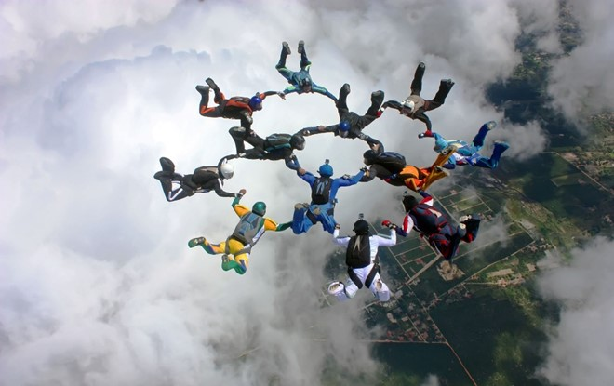
Having close and inclusive professional relationships will always involve differences in communication styles, work ethics and opinions about the organisation.
You are likely to find advantages and disadvantages in workplace relations.
Appreciate Diversity and Inclusiveness, and Their Benefits

Slide 62
You can contribute to the development of the workplace based on the appreciation of diversity and inclusiveness by:
Following organisational policies and procedures
Participating in the surveys and consultation regarding diversity and inclusiveness
Attending seminars and training regarding cultural appreciation and applying them to your workplace
Appreciate Diversity and Inclusiveness, and Their Benefits

Slide 63
You can contribute to the development of the workplace based on the appreciation of diversity and inclusiveness by:
Cultivating the following values:
Respect
Openness
Effective communication
Equality
Understanding
Appreciate Diversity and Inclusiveness, and Their Benefits

Slide 64
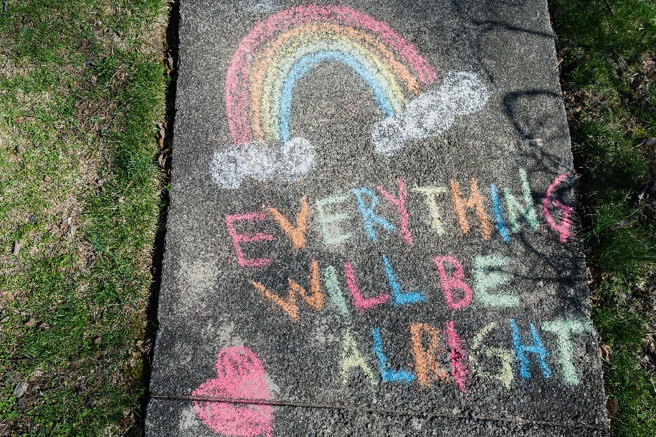
Some things to consider in contributing to the development of professional relationships based on the appreciation of diversity and inclusiveness:
Maintain a positive attitude
Improve your communication skills
Resolve conflicts early on
Treat all workers with respect
Share information about cultural practices
Anticipate cultural differences
Appreciate Diversity and Inclusiveness, and Their Benefits

Slide 65

2.3 Use Work Practices that Make Environments Safe for All

Slide 66
2.3 Use Work Practices that Make Environments Safe for All
Acknowledge and embrace cultural safety and unique linguistic and cultural backgrounds of individuals.
Cultural safety is where a person in their culture is confident, accepted and respected and that their service providers will embrace cultural considerations.
Being free from fear, anxiety and feelings of discomfort is when people feel culturally safe and feel accepted, comfortable and included.
Appreciate Diversity and Inclusiveness, and Their Benefits

Slide 67
As mentioned earlier in this Learner Guide, the principal of cultural competence is acceptance and recognition of differences between seeing such differences and people from a positive perspective.
Competent principles and practices culturally demonstrate an acknowledgement of respect for people of all ethnic, racial, linguistic, cultural and religious backgrounds.
Cultural competence is a process developmentally- there will always be room for improvement no matter how culturally adept we are.
Appreciate Diversity and Inclusiveness, and Their Benefits

Slide 68
Cultural competency consists of:
Acceptance and awareness of cultural differences.
Cultural values of one’s own awareness.
Recognising people from different cultures have different ways of behaving, interpreting, communicating and problem-solving.
Ability and willingness to adapt to being sensitive to the needs of co-educators cultural backgrounds.
Appreciate Diversity and Inclusiveness, and Their Benefits

Slide 69

This means being culturally competent at work, having the ability and will to unique needs arising and being able to respond to these from each individuals culture.
In an organisation, no matter our position, we each have a role to play to achieve cultural competence.
We can achieve more through teamwork than as individuals.
Appreciate Diversity and Inclusiveness, and Their Benefits

Slide 70
2.3.1 Providing for the Needs of Marginalised Groups
To practise equity in a diverse workplace is giving special consideration to the needs of marginalised group, which involves safeguarding them from risk factors by providing various protective factors.
Risk and Protective Factors
Risk factors are entities or situations that can cause negative effects.
The opposite happens with protective factors, where positive effects come up.
Clients may have different risk or protective factors depending on their background, culture, experiences and other traits.
Appreciate Diversity and Inclusiveness, and Their Benefits

Slide 71

Proper accounting of risk and protective factors will have to be performed on a case–to–case basis.
When identifying risk or protective factors, refer to relevant documents or information sources unique to the person concerned.
Do not make assumptions.
Appreciate Diversity and Inclusiveness, and Their Benefits

Slide 72
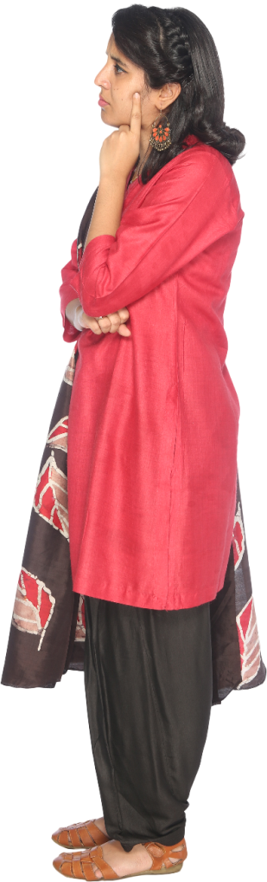
2.3.2 Other Care Needs
Diverse people can have various physical, mental and emotional health issues and care needs.
People may require direct or indirect assistance to address these needs and may ask for your help or consideration.
Workers such as yourself are expected to assist in facilitating access to these needs as part of their work duties.
The organisation must put an effort in accommodating these people.
Appreciate Diversity and Inclusiveness, and Their Benefits

Slide 73
Negative experiences can:
Cause a person to be on guard
Affect the level of service you provide
Cause difficulties in identifying other needs that need to be addressed
Appreciate Diversity and Inclusiveness, and Their Benefits

Slide 74
2.3.3 Using Diversity Practices and Experiences
One way your workplace can provide a safe environment for diverse people is by using diverse practices and experiences.
These practices and experiences are activities, either routine or occasional, that can:
Improve the cultural awareness of all people in the workplace
Prevent conflicts and arguments due to differences in culture
Create opportunities to address existing issues and concerns
Allow everyone to stand on equal footing in terms of ideas and opinions
Appreciate Diversity and Inclusiveness, and Their Benefits

Slide 75

What have we learned?
In this part of the session, we have covered:
Reflect on your perspectives
Appreciate diversity and inclusiveness, and their benefits
Communicate with people from diverse backgrounds and situations
Promote understanding across diverse groups

Slide 76
End of Chapter 2

